Slide 1

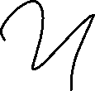
Convolutional Neural Network

Slide 2
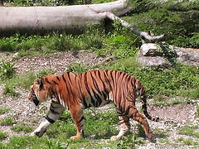
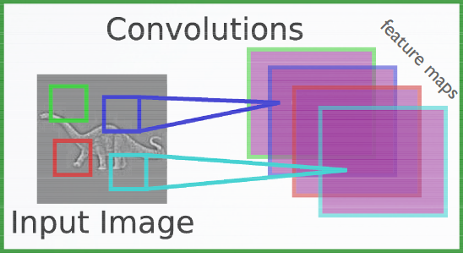
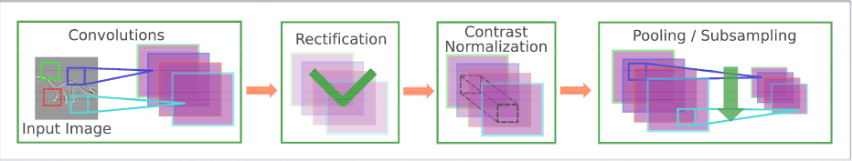

Convolutional Neural Networks (CNNs)
CNNs vs MLPs
Naively using MLP to classify 224x224x3 (~ 3 x 40,000) typical ImageNet image -> parameter explosion
Doesn’t exploit local spatial information
Can we build special neural nets for images exploiting
2D topology of pixels
Achieve invariance to translation ?
Category: tiger
ImageNet
Convolutional networks leverage these ideas,
Local connectivity
Parameter sharing
Pooling/ Subsampling
ReLu (rectifier) nonlinearity
*slide courtesy, Hugo Larochelle course on Neural networks
MLPs FC parameter explosion
Local processing (feature sharing)
Invariances (scale, translation) - convolution takes care of this
Feature abstraction - compositional

Slide 3
Convolutional Neural Networks (CNNs)
What we will learn about CNNs?
Introduction
State of the art architectures
CNNs over fully connected
Different layers in CNN
Convolutional layer
RelU
Pooling layer
Fully connected layer
AlexNet and VGG Net
GoogLeNet (inception module)
ResNets (Residual module) CVPR’ 17 best paper

Slide 4
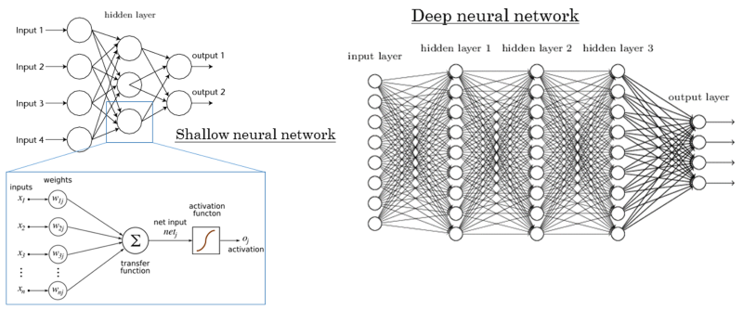
CNNs over Multi-layer neural networks (MLNN)
Multi-layer neural network
CNNs are multi-layer neural network with two constraints:
Local connectivity
Parameter sharing

Slide 5
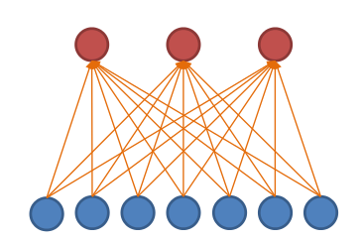
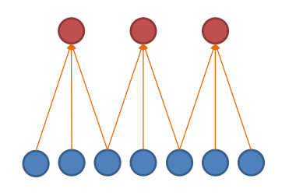
CNN: Local connectivity (LC)
Hidden layer (3 nodes)
Input layer (7 nodes)
MLNN ( 7 X 3 = 21 parameters)
MLNN-LC ( 3 X 3 = 9 parameters)
2.3X runtime and storage efficient.
In general for a level with m input and n output nodes and CNN-local connectivity of k nodes (k<m):
MLNN have
m x n parameters to store.
O(m x n) runtime
MLNN-LC have:
k x n parameters to store.
O(k x n) runtime

Slide 6
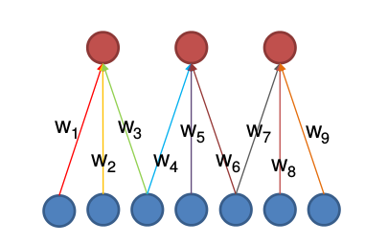
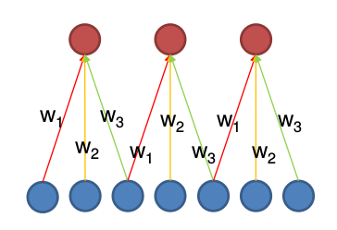
CNN: Parameter sharing (PS)
MLNN (21 parameters)
MLNN-LC ( 3 X 3 = 9 parameters)
2.3X runtime and storage efficient.
MLNN-LC-PS (3 parameters)
2.3X faster,
& 7X storage efficient.
In general for a level with m input and n output nodes and CNN-local connectivity of k nodes (k<m):
MLNN have
m x n parameters to store.
O(m x n) runtime
MLNN-LC have:
k x n parameters to store.
O(k x n) runtime
MLNN-LC-PS have:
k parameters to store.
O(k x n) runtime

Slide 7
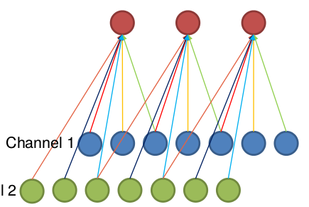
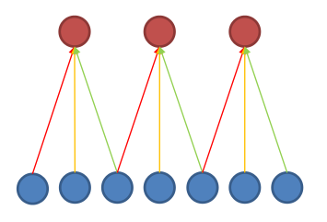
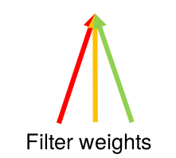
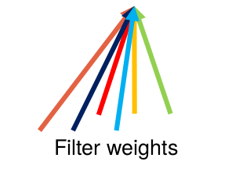
CNN with multiple input channels
Channel 2
Single input channel
Two input channels

Slide 8
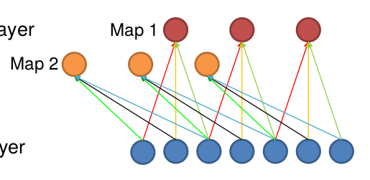
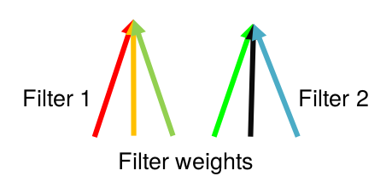
CNN with multiple output maps
Single input map
Two output maps

Slide 9
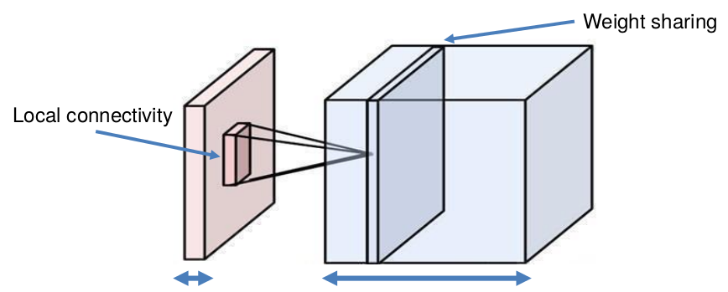
A generic level of CNN
Parameter sharing
Local connectivity
# input channels
# output maps

Slide 10
Different layers in CNN architecture (pooling, relu, etc.)

Slide 11
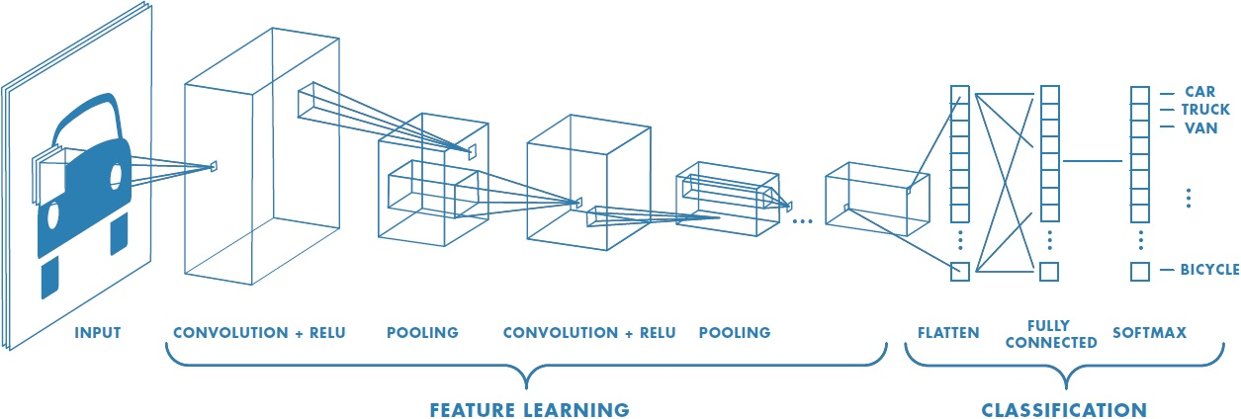
Different layers of CNN architecture

Slide 12
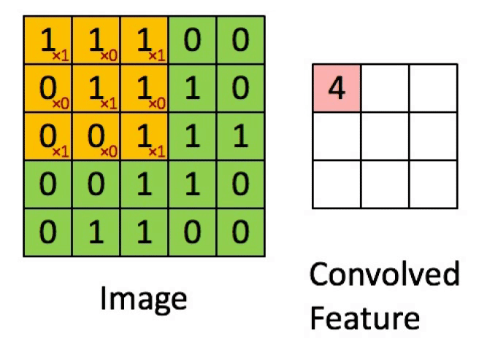
CNN: Convolutional layer
To reduce the number of weights (through local connectivity).
To provide spatial invariance (through parameter sharing).

Slide 13
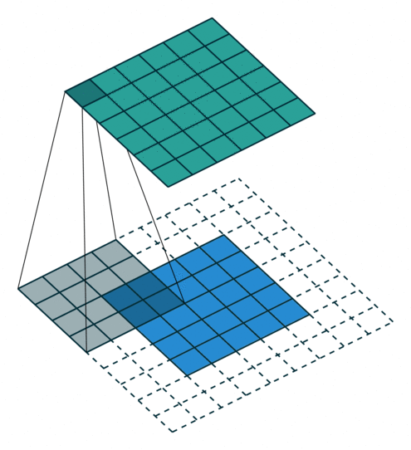

Hyper parameters for convolutional layer.
Zero padding (to control input size spatially.)
Without padding (i.e., [0,0])
With padding [2,2]

Slide 14

Hyper parameters for convolutional layer.
2. Stride (to produce smaller output volumes spatially.)
Without stride (i.e., [1,1])
With stride [2,2]

Slide 15

Hyper parameters for convolutional layer.
Both padding and stride
Without padding and stride
With padding [1,1] & stride [2,2]

Slide 16

CONVOLUTIONAL LAYER
Accepts a volume of size W1 X H1 X D1.
Requires four hyperparameters:
Number of filters K
the spatial extent of filter F
their stride S
the amount of zero padding P
Produces an output volume of size W2 X H2 X D2 where:
W2=(W1−F+2P)/S+1, H2=(H1−F+2P)/S+1, D2=K
With parameter sharing, it introduces F⋅F⋅D1 weights per filter, for a total of (F⋅F⋅D1)⋅K weights and K biases.
In the output volume, the d-th depth slice (of size W2 X H2) is the result of performing a valid convolution of the d-th filter over the input volume with a stride of S, and then offset by d-th bias.

Slide 17
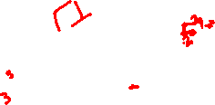
Different layers of CNN architecture

Slide 18

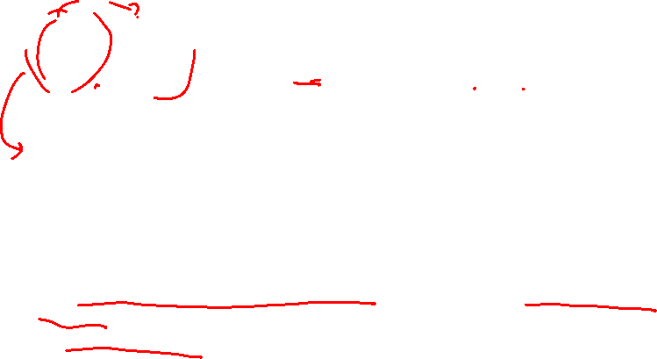
CNN: Pooling layer
To reduce the spatial size of the representation to reduce the amount of parameters and computation in the network.
Average pooling or L2 pooling can also be used, but not popular like max pooling.

Slide 19

POOLING LAYER
Accepts a volume of size W1 X H1 X D1.
Requires two hyperparameters:
the spatial extent of filter F
their stride S
the amount of zero padding P (commonly P = 0).
Produces an output volume of size W2 X H2 X D2 where:
W2=(W1−F+2P)/S+1, H2=(H1−F+2P)/S+1, D2=K

Slide 20
Different layers of CNN architecture

Slide 21
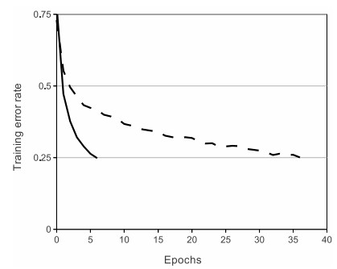
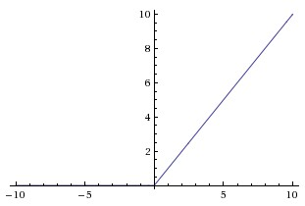
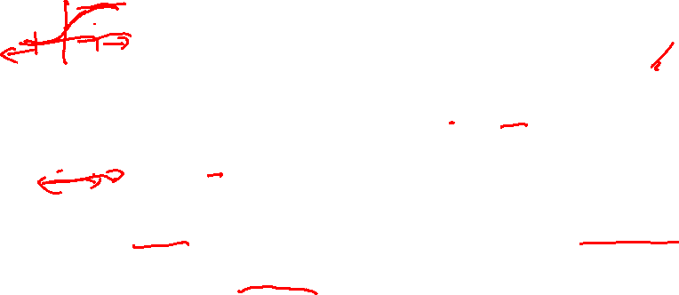
Activation functions: Rectified Linear Unit (very popular).
6X improvement in convergence
tanh
ReLU
Advantage 1: Eliminate saturation and killing of gradients for positive inputs.
Advantage 2: Greatly accelerate convergence of SGD. (Krizhevsky et al. argued that this is due to its linear, non-saturating form.)
Advantage 3: tanh/sigmoid neurons involve expensive operations (exponentials, etc.), whereas ReLU can be implemented by simply thresholding activations at zero.
Notes:
t was found to greatly accelerate (e.g. a factor of 6 in Krizhevsky et al.) the convergence of stochastic gradient descent compared to the sigmoid/tanh functions. It is argued that this is due to its linear, non-saturating form.
(+) Compared to tanh/sigmoid neurons that involve expensive operations (exponentials, etc.), the ReLU can be implemented by simply thresholding a matrix of activations at zero.

Slide 22
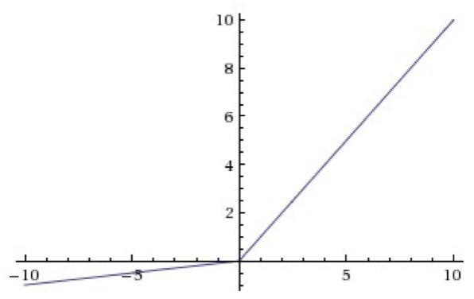
Activation functions: Leaky ReLU.
Instead of the function being zero when x < 0, a leaky ReLU will instead have a small negative slope (a hyper-parameter).
Advantages: Eliminate irreversible dying of neurons, as in ReLU.
Have all the advantages of ReLU.

Slide 23
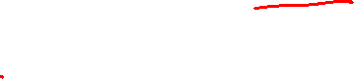
Different layers of CNN architecture

Slide 24
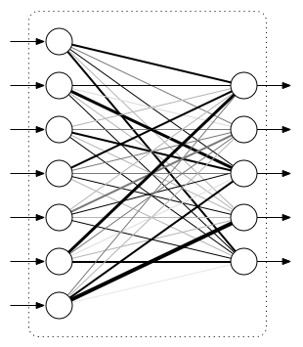
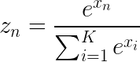
Flattening, fully connected (FC) layer and softmax
Class probabilities
Flattening
Vectorization (converting M X N X D tensor to a MND X 1 vector).
FC layer
Multilayer perceptron.
Generally used in final layers to classify the object.
Role of a classifier.
Softmax
Fully connected
Softmax layer
Normalize output as discrete class probabilities.

Slide 25

A CNN Example

Slide 26
Basics of CNN:
Advantage of CNN over MLP
Local connectivity
Parameter sharing
Efficient runtime and storage
Different layers in CNN
Convolutional layer
ReLU
Pooling
Fully connected layer

Slide 27
Convolutional Neural Networks (CNNs)
Introduction
State of the art architectures
CNNs over fully connected
Different layers in CNN
Convolutional layer
RelU
Pooling layer
Fully connected layer
AlexNet
VGG Net
GoogLeNet (inception module)
ResNets (Residual module) CVPR’ 17 best paper

Slide 28
CNN Architectures
Slides taken from CS231n lecture slides

Slide 29
Case study of following CNN architectures
LeNet
AlexNet
VGG
GoogLeNet
ResNet

Slide 30
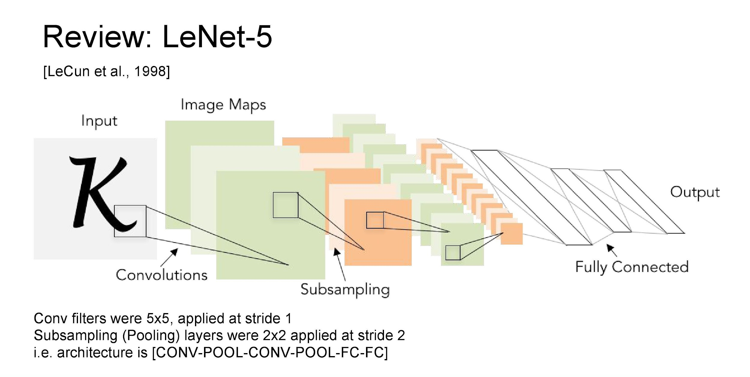



Slide 31
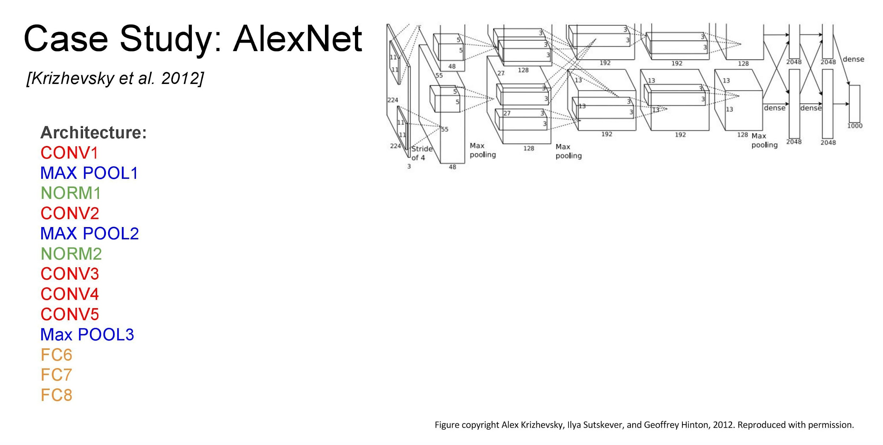
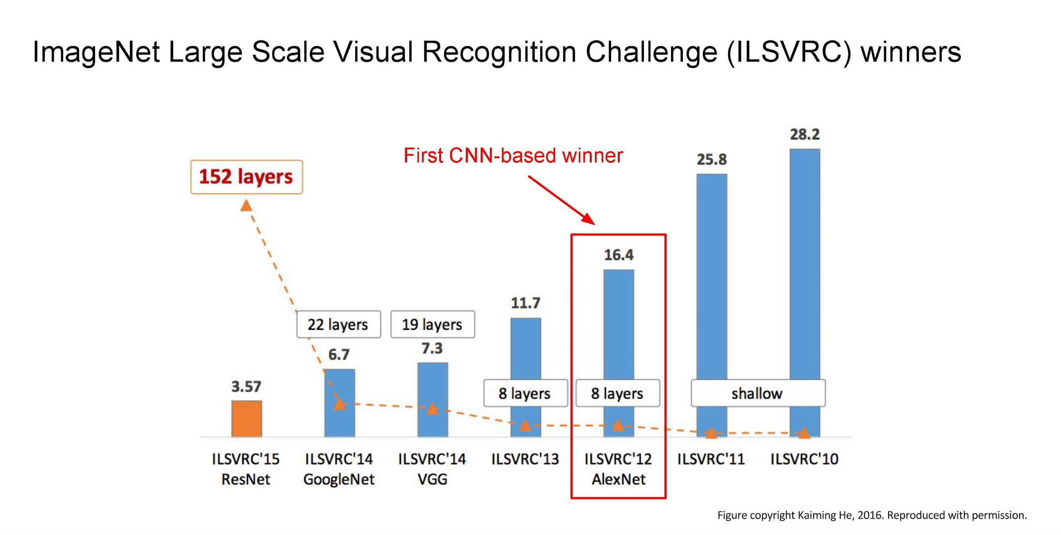
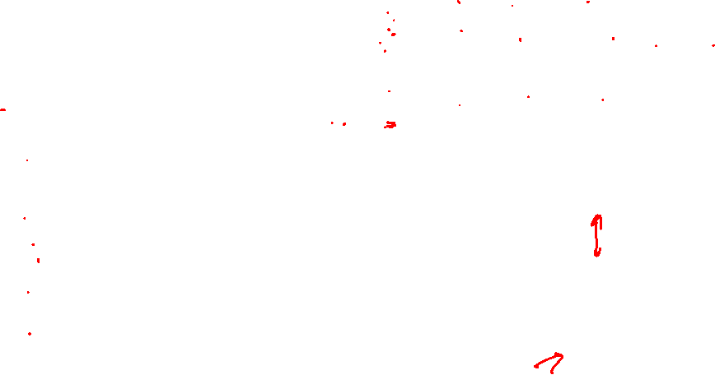

Slide 32
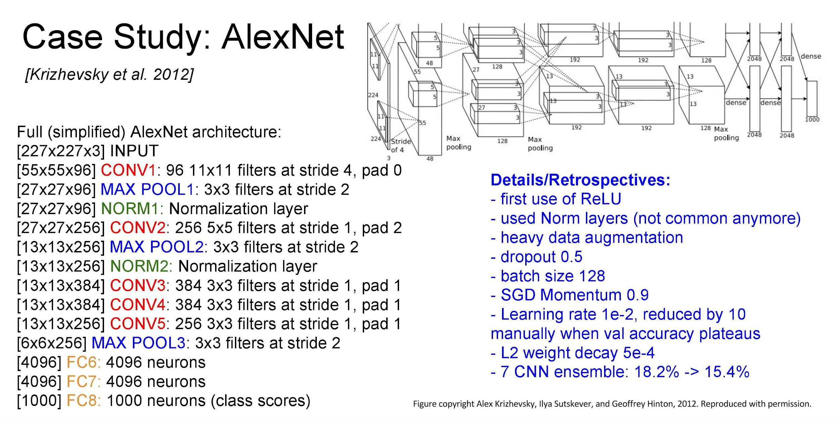
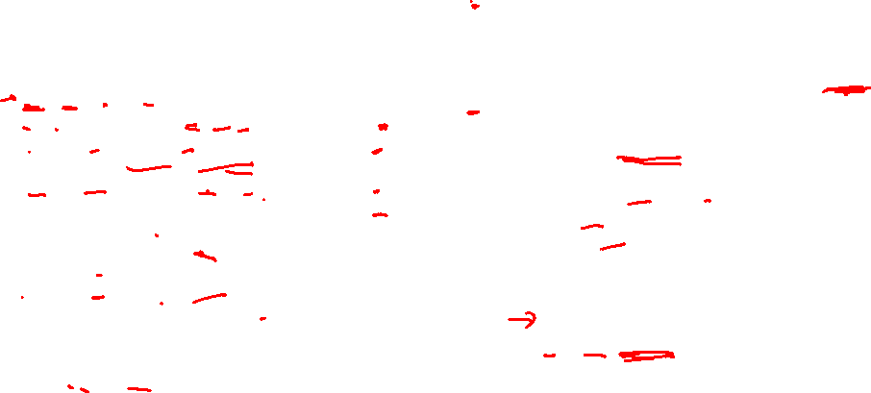
Notes:
Local response normalization to limit unbounded activation and for lateral inhibition
https://towardsdatascience.com/difference-between-local-response-normalization-and-batch-normalization-272308c034ac#:~:text=Local%20Response%20Normalization%20(LRN)%20was,and%20sigmoid%20at%20that%20time.&text=LRN%20is%20a%20non%2Dtrainable,a%20within%20a%20local%20neighborhood.

Slide 33
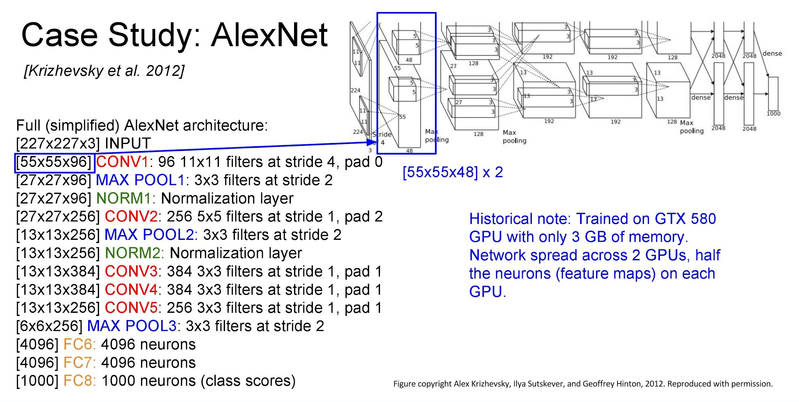

Slide 34

Note on Alexnet
Notice the use of filters of size 11x11 in the initial layer.
It increases the number of parameters that need to be trained
Recent CNNs use cascade of small filters of size 3*3 or 5*5.

Slide 35
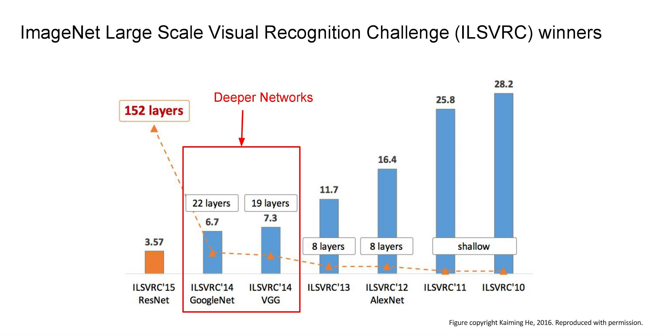


Slide 36
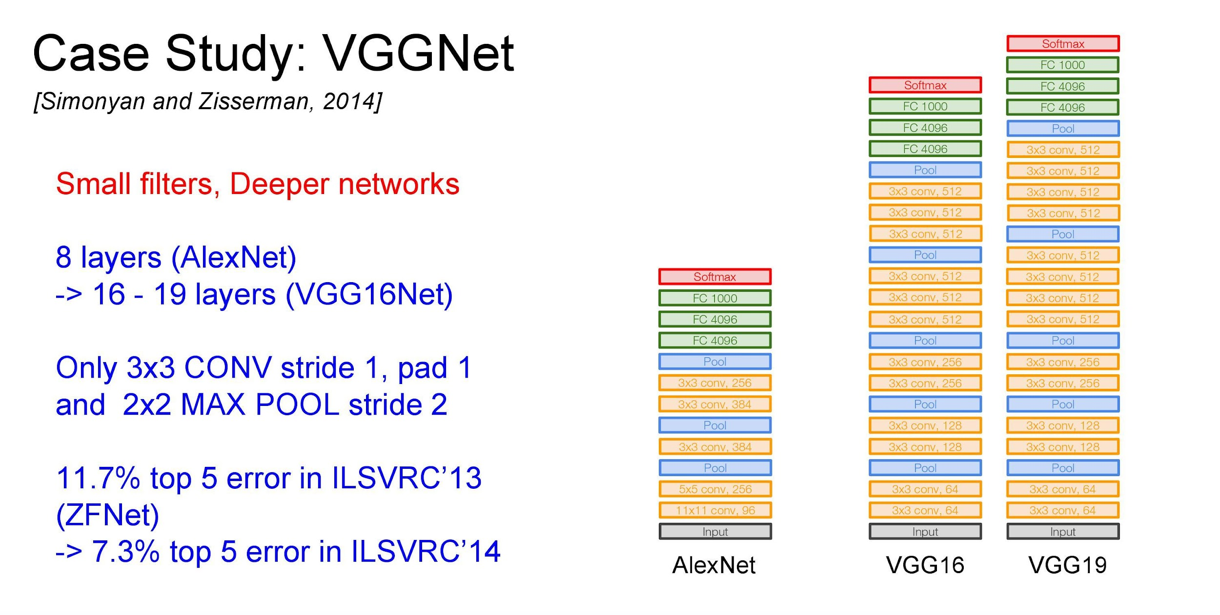
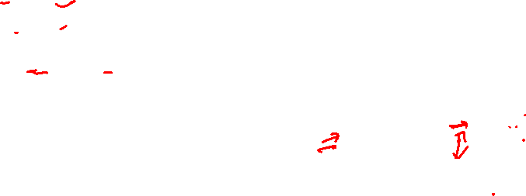

Slide 37
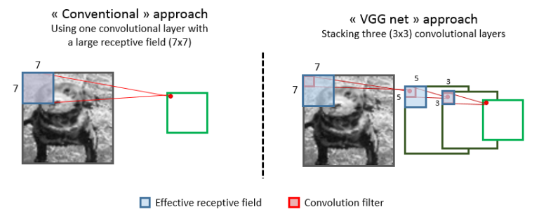
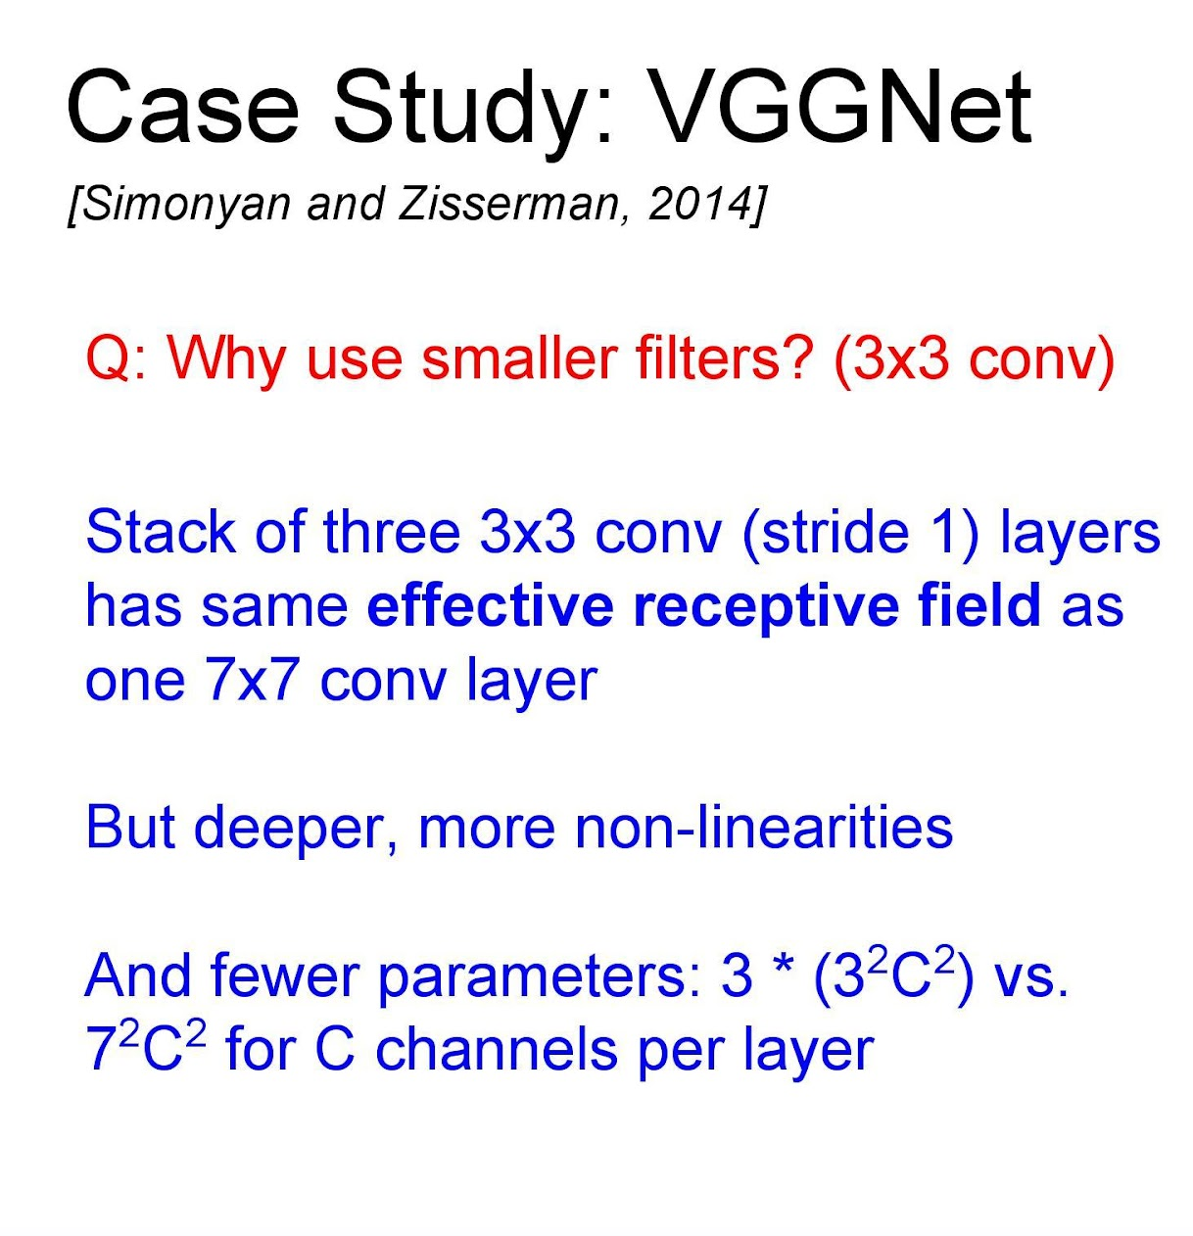
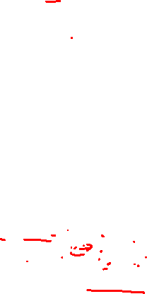

Slide 38
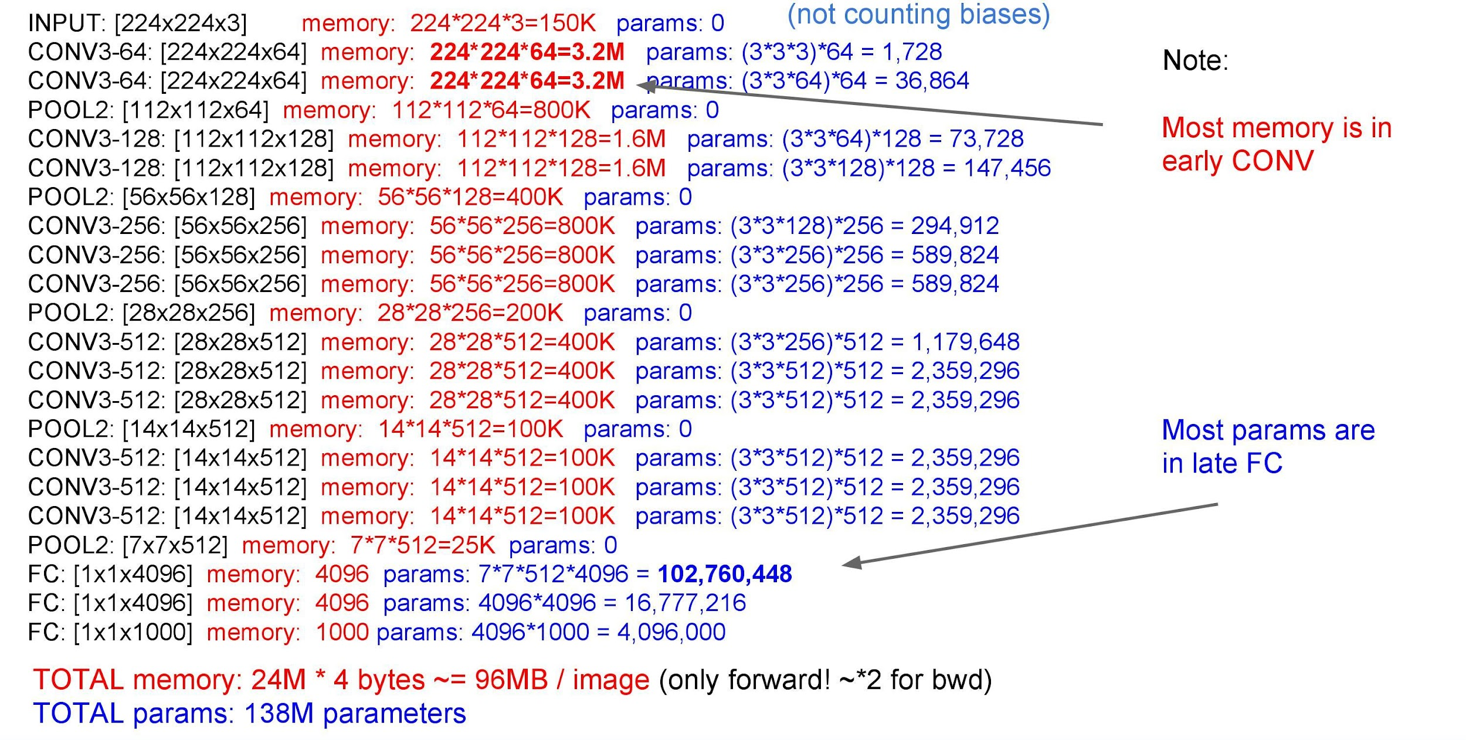



Slide 39
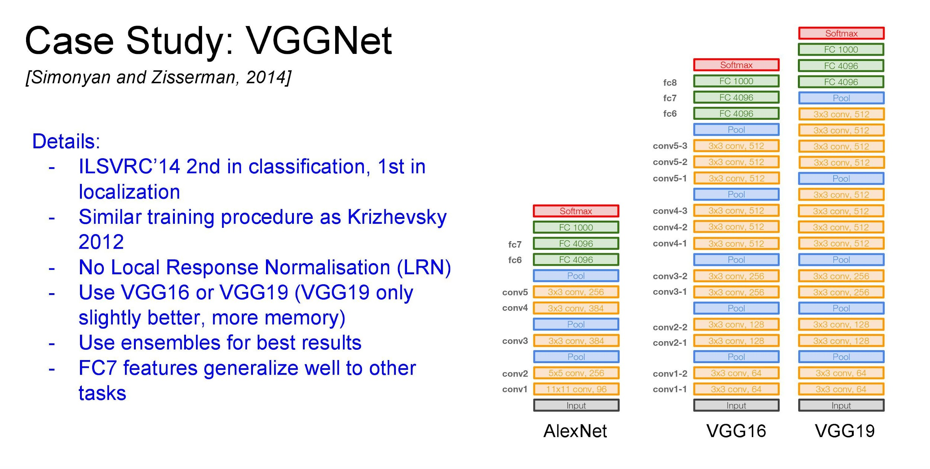
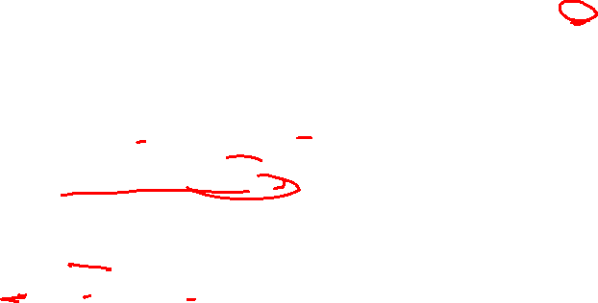

Slide 41
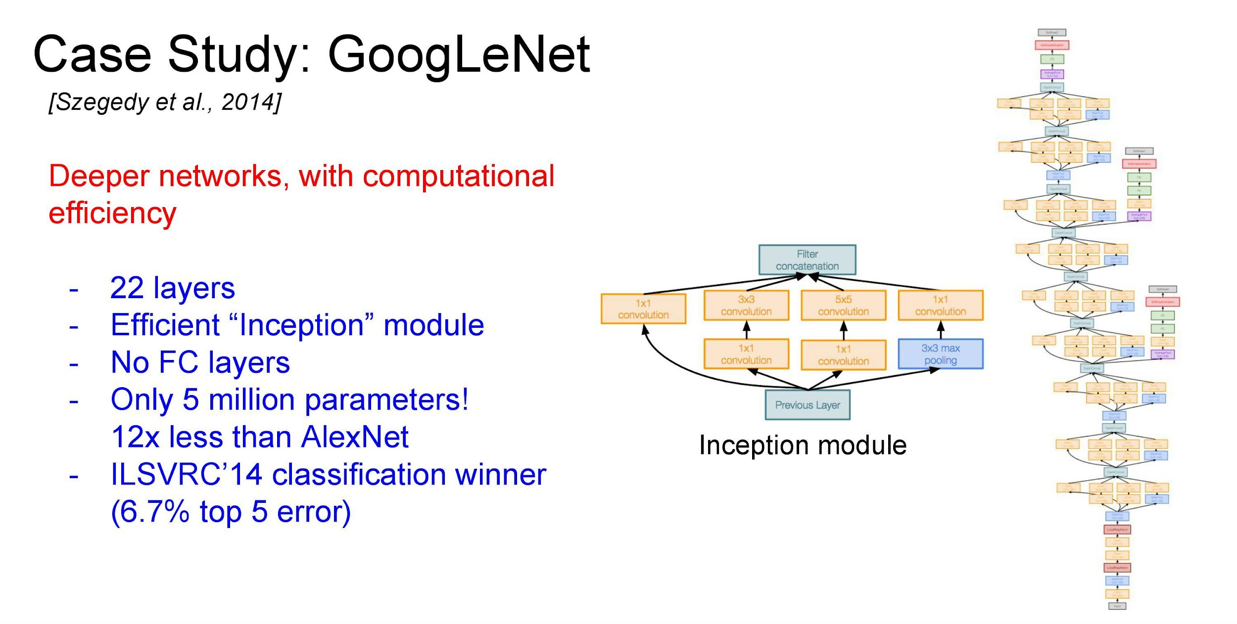
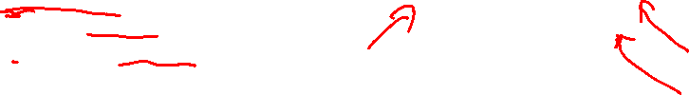

Slide 42
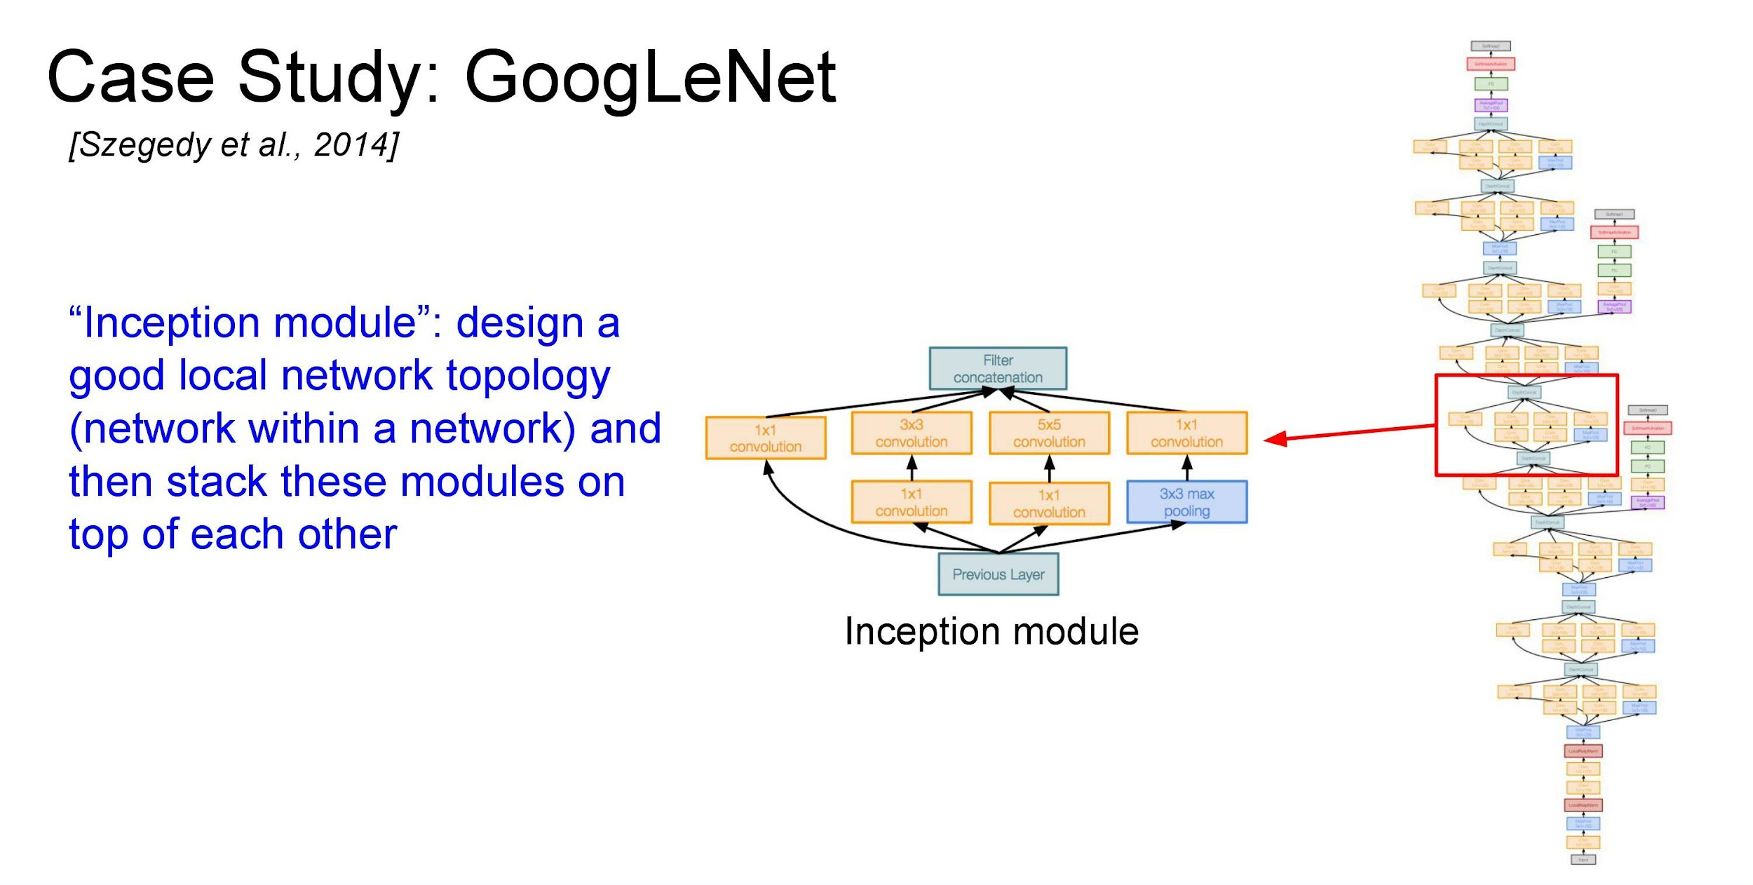
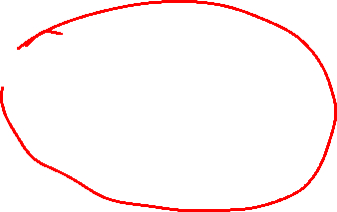

Slide 43
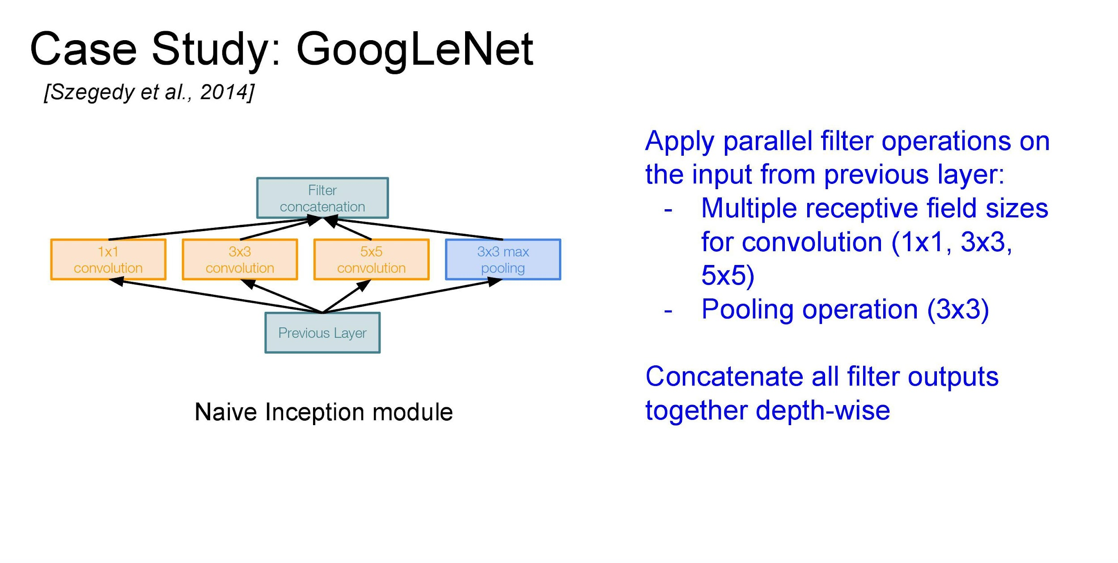
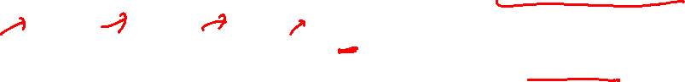

Slide 44


1x1 Convolutions

Slide 45

1x1 Convolutions

Slide 46



Slide 47



Slide 48


Slide 49


Slide 50


Slide 51


Slide 52



Slide 53


Slide 54



Slide 55


Slide 56


Slide 57



Slide 58


Slide 59



Slide 60



Slide 61



Slide 62


Slide 63


Slide 64


Slide 65



Slide 66


Slide 67


Slide 68



Slide 69



Slide 70


Slide 71



Slide 72


Slide 73



Slide 74



Slide 75



Slide 76


Slide 77


Slide 78



Slide 79

Notes:
https://towardsdatascience.com/difference-between-local-response-normalization-and-batch-normalization-272308c034ac#:~:text=Local%20Response%20Normalization%20(LRN)%20was,and%20sigmoid%20at%20that%20time.&text=LRN%20is%20a%20non%2Dtrainable,a%20within%20a%20local%20neighborhood.

Slide 80


Slide 81


Slide 82
Convolutional Neural Networks (CNNs)
What we learnt about CNNs?
Introduction
State of the art architectures
CNNs over fully connected
Different layers in CNN
Convolutional layer
RelU
Pooling layer
Fully connected layer
AlexNet and VGG Net
GoogLeNet (inception module)
ResNets (Residual module) CVPR’ 17 best paper

Slide 83



Activation functions: Sigmoidal function
Sigmoids saturate and kill gradients (when the neuron’s activation saturates at either tail of 0 or 1).
0 ⇒ fails to update weights while back-prop.
Notes:
Sigmoids saturate and kill gradients. A very undesirable property of the sigmoid neuron is that when the neuron’s activation saturates at either tail of 0 or 1, the gradient at these regions is almost zero. Recall that during backpropagation, this (local) gradient will be multiplied to the gradient of this gate’s output for the whole objective. Therefore, if the local gradient is very small, it will effectively “kill” the gradient and almost no signal will flow through the neuron to its weights and recursively to its data. Additionally, one must pay extra caution when initializing the weights of sigmoid neurons to prevent saturation. For example, if the initial weights are too large then most neurons would become saturated and the network will barely learn.

Slide 84
Activation functions: Rectified Linear Unit (very popular).
Drawback: ReLU units can irreversibly die during training. A large gradient flowing through a ReLU neuron could cause the weights to update in such a way that the neuron will never activate on any datapoint again.
0 ⇒ fails to update weights while back-prop.
Notes:
(-) Unfortunately, ReLU units can be fragile during training and can “die”. For example, a large gradient flowing through a ReLU neuron could cause the weights to update in such a way that the neuron will never activate on any datapoint again. If this happens, then the gradient flowing through the unit will forever be zero from that point on. That is, the ReLU units can irreversibly die during training since they can get knocked off the data manifold. For example, you may find that as much as 40% of your network can be “dead” (i.e. neurons that never activate across the entire training dataset) if the learning rate is set too high. With a proper setting of the learning rate this is less frequently an issue.

